Slide 1


Sales Data Analysis
ABC Electronics
11-Jan, 2023
Mayank Porwal (Data Analyst)

Slide 2

Agenda
Introduction
Data Used for Analysis
Concerns About The Company
Suggestions
Dashboard snapshot
Summary

Slide 3

Introduction
Today we will analyze, review and understand business problem using some insights about sales from data and Try to get some suggestions what could be done to improve the concerns for the company.

Slide 4

Data Source
We have used sales data that has information like sales date, customer id, product name, category of the product, order value and region of order.

Slide 5

Major Insights/ Concerns
Let’s dive in

Slide 6
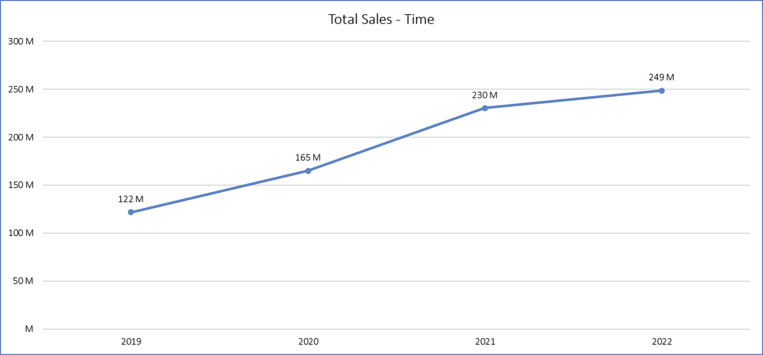
Sales
Sales has become stagnant lately which is only 8% growth in sales from 2021 – 2022 one of the major concerns and this is across all the categories except switchgears.
Suggestion: Need to work with sales department and understand the reason behind. Lately sales has reduced majorly because of drop in Pipes sale so need to understand what is the need of market that has changed.

Slide 7
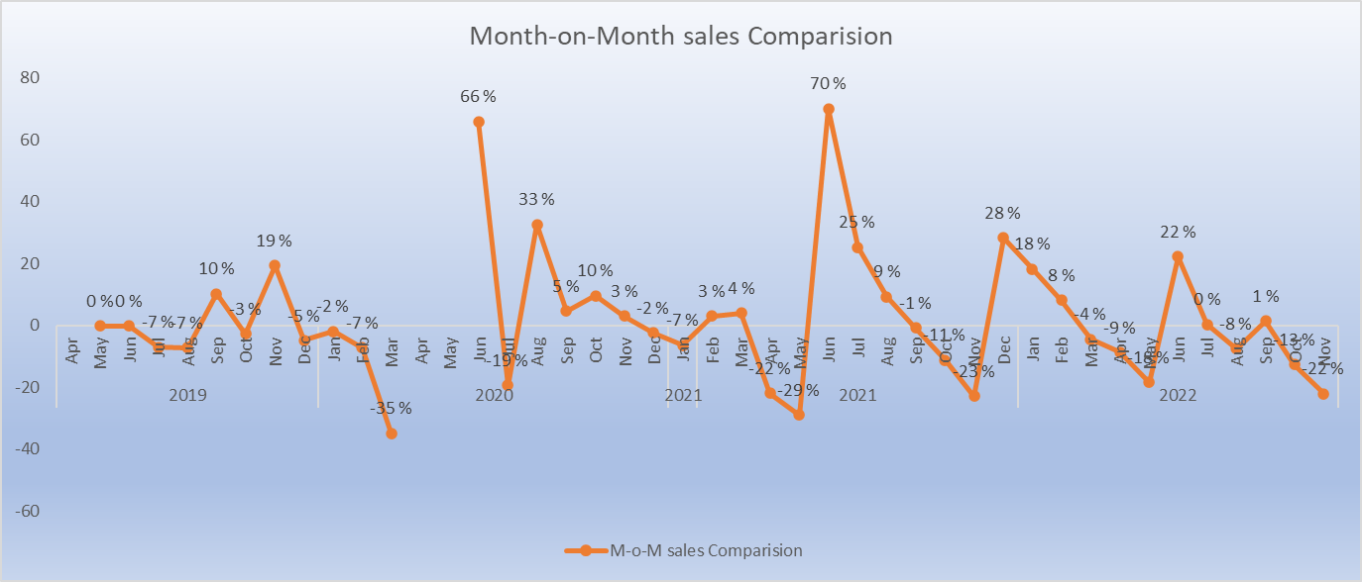
Inconsistency in sales
Our sales has not really been increasing or even consistent when checked Month-on-Month basis we see that only 18 out of 41 months have seen positive sales growth where as in 23 months we have negative sales when compared to previous month. (here we have not considered April-May 2020 as they where heavily effected by covid and could be misguiding)
Suggestion: We are able to survive based on some bulk deals by some handful of customers which is dangerous we should work on developing relation with our customer such that he continuously buy the product of our company

Slide 8
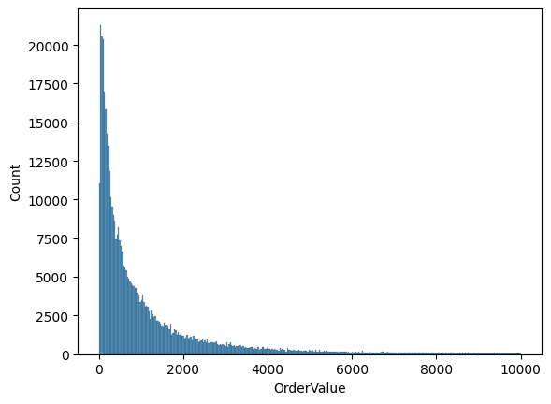
Distribution of OrderValue
The ‘ordervalue’ of Sales Data are very Skewed Towards values closer to range “0-500” .
50% of orders are have order value below ₹550 which is major point of concern.
Also as we see in Table below only 21.2% orders are above average order value/per order of ₹1720.
Suggestion: various scheme could be run like on order value of ₹2000 and above will get some special discount or reward points that will attract customers to buy a minimum order value in each order to earn these rewards which can increase our avg. ordervalue/order, thus our sales will improve
In this histplot. Only ordervalue<10K are taken for better visualization.
Total count of orders | Count of Orders Above Avg. ordervalue (~₹1720)
444801 | 94653

Slide 9
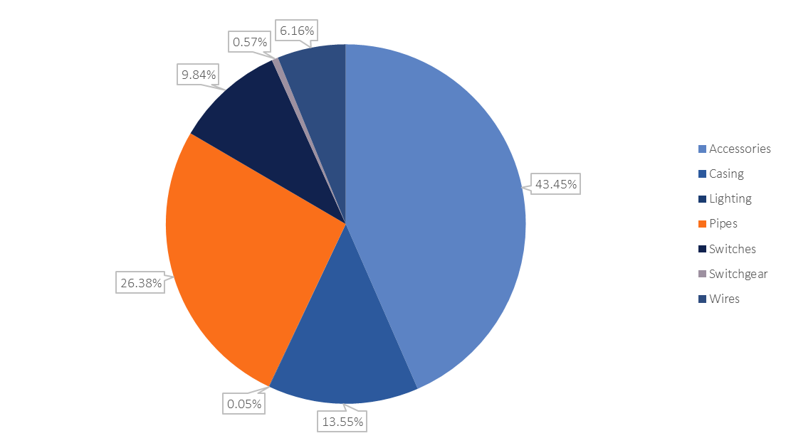
Category wise - Contribution in Sales
Here Lighting Category is the least (0.05%) | As we launched this category of products in year 2022 only.

Slide 10
Category wise Compounded Sales
Opportunities
Category | 2019 | 2020 | 2021 | 2022 | CAGR
Accessories | 59119688 | 75453090 | 95721569 | 102308497 | 15%
Casing | 15209927 | 23965550 | 31979338 | 32528024 | 21%
Lighting | 0 | 0 | 0 | 355599 | 100%
Pipes | 24748378 | 36293033 | 67467093 | 73425175 | 31%
Switches | 14987878 | 20858895 | 20133124 | 19317457 | 7%
Switchgear | 0 | 133746 | 1083689 | 3183705 | 188%
Wires | 7617611 | 8192358 | 13889891 | 17468642 | 23%
Here we have a good thing to look upon which is we can clearly focus more on Switchgear category more as it is showing excellent scope of sales improvement
And also working on lighting category we can increase our revenue. But that also has been some signs of inconsistency.

Slide 11

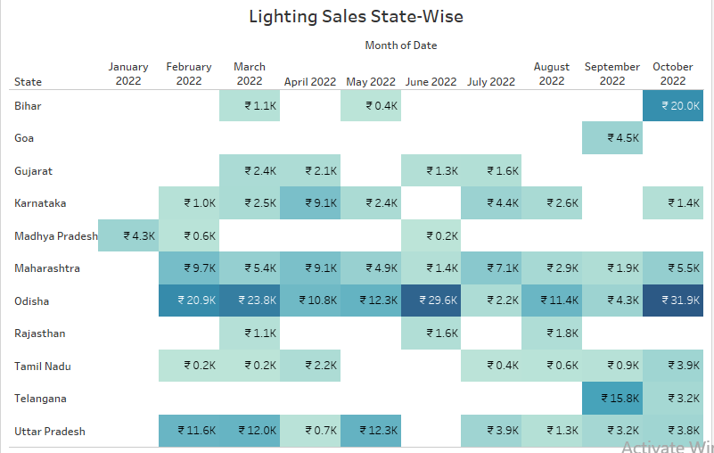
Understanding Lighting Category
There are signs of rejection of our lighting products from different states like Madhya Pradesh, Rajasthan and others.
Because as we see the sales has only increased only in Odisha so we need understand what are things that customers at ohias are happy with or what our Salesmen in Odisha able to understand about Lighting category, which we can also implement to other states for this category.

Slide 12
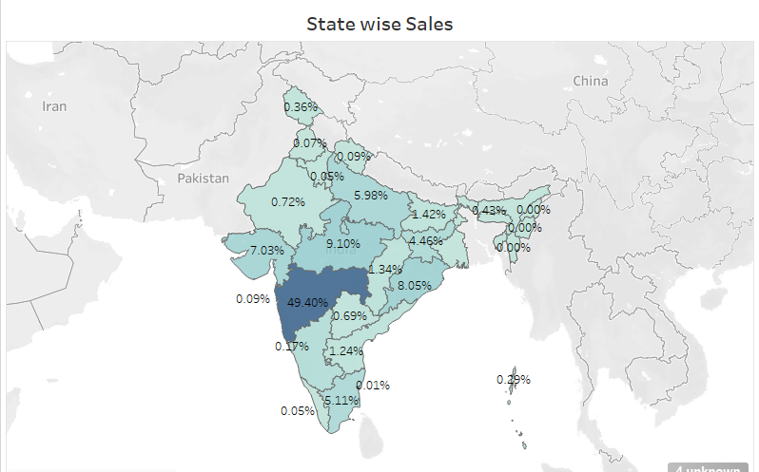
Geographic Statistics
Need to diversify our Sales pan India which can improve our sales also which will build Warehouses – Manufacturing units in different other States of India which will help achieve the goal of expansion and diversification.

Slide 13

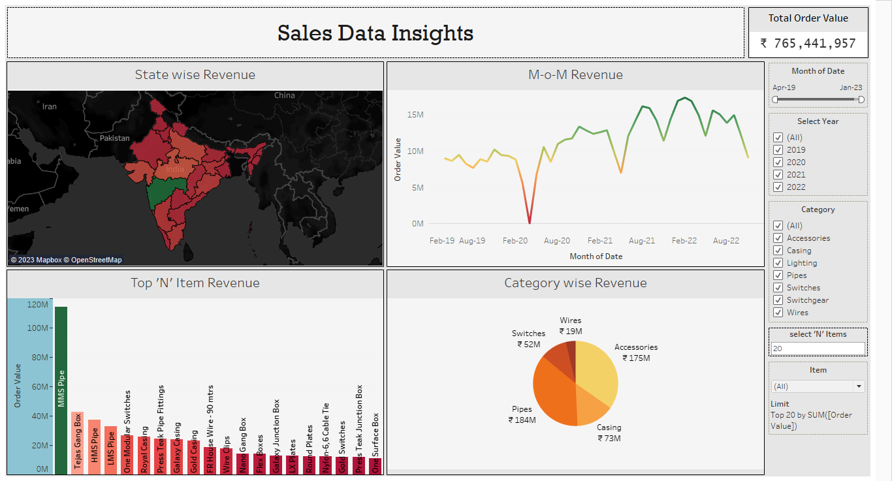
Dashboard Snap-Shot

Slide 14

Conclusion
For Expanding business pan India which will reduce our dependency on handful of customers should build either Warehouses in different states or Setup Manufacturing units if possible to diversify.
We need to focus on sales of pipe category products concerns.
And Development of Switchgear products which can is seeing good growth can help company grow its sales exponentially
Also Lighting category which is just launched will need our attention

